Slide 1

jQuery
Ranken Technical College

Slide 2
Objectives
jQuery CDN vs. Download
Understand Basic jQuery Selectors
Using Event Handling in jQuery
Add vs. Remove vs. Toggle Classes
Using jQuery for Form Validation
Using jQuery for CRUD

Slide 3
Installing jQuery
Downloading jQuery or hosting it on a CDN.

Slide 4
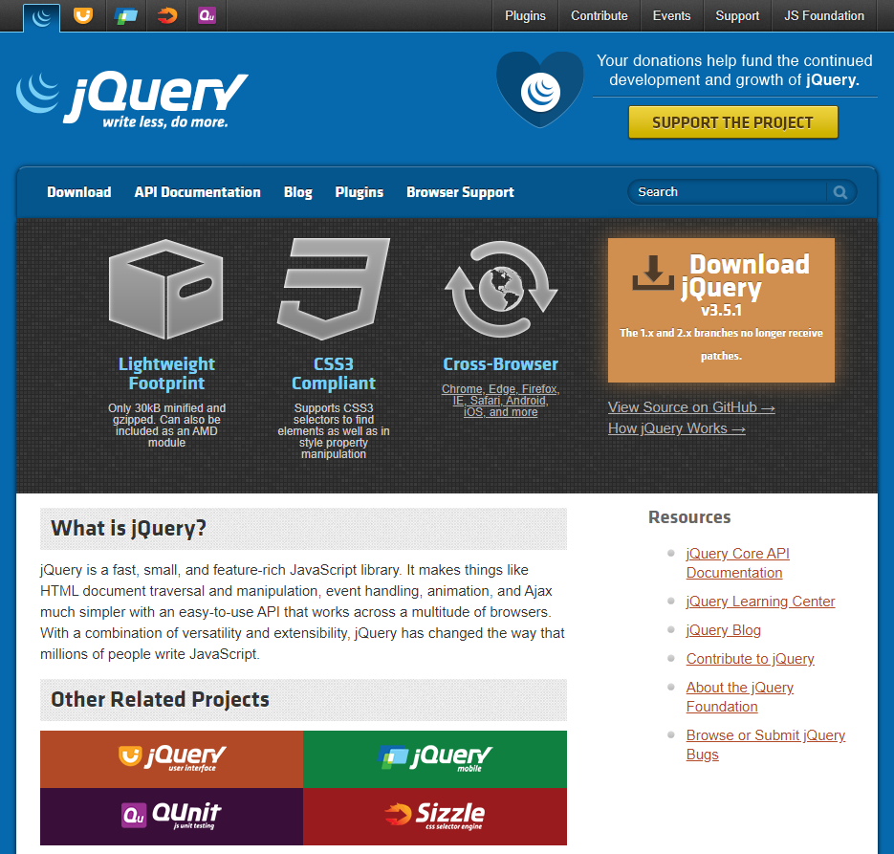
jQuery Website
The jQuery website (https://jquery.com/) provides comprehensive documentation of the entire jQuery library and many helpful articles to get you started.
Notes:
https://jquery.com/

Slide 5
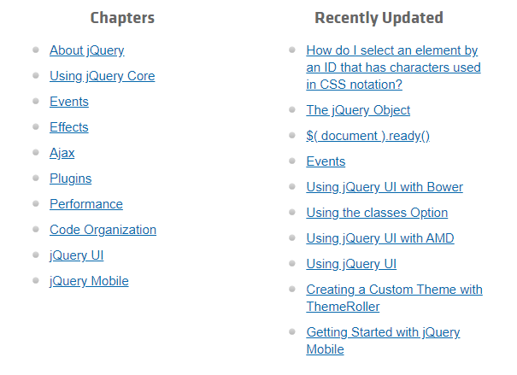
jQuery Learning Center
You can find several helpful tutorials in the jQuery Learning Center (https://learn.jquery.com/)
Notes:
https://jquery.com/

Slide 6
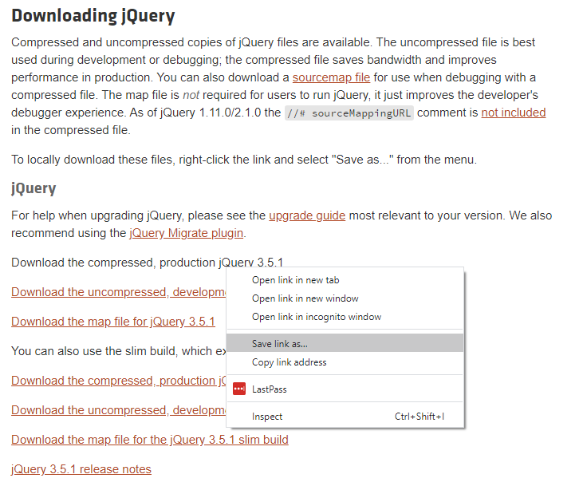
Downloading jQuery
You can download jQuery directly from
the Download page.
Do this in Chrome by right-clicking the link and selecting Save link as…
Make sure to dowload the compressed production version.

Slide 7
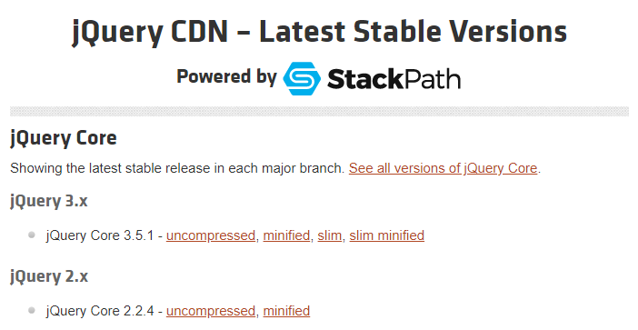
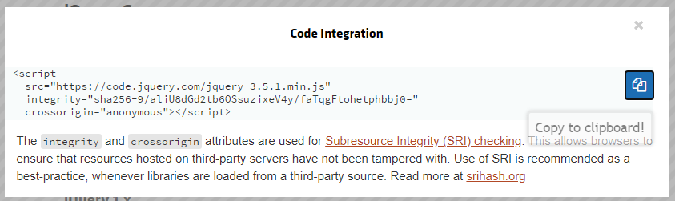
jQuery via CDN
Or you can use jQuery via a CDN.
Get the script tag here
https://code.jquery.com/
Make sure to get the minified version.
Also make sure that the protocol is https.
For security, be sure to include the integrity and crossorigin properties as shown.

Slide 8
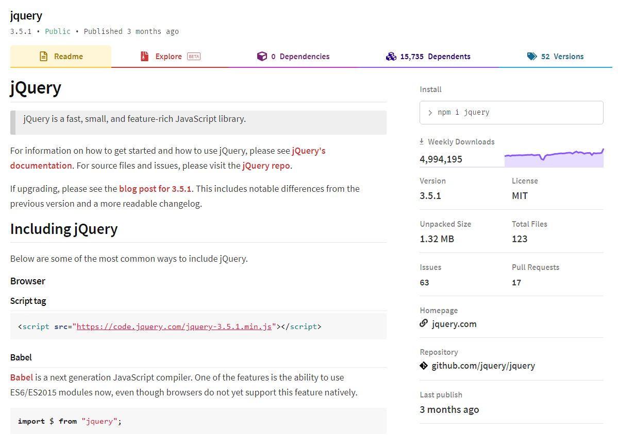
jQuery via npm
You can also download jQuery as an npm package, which we will discuss later in the course.
https://www.npmjs.com/package/jquery

Slide 9
CDNs
Hosting front-end libraries with a CDN. Why or why not?

Slide 10
What is a CDN?
A Content Delivery Network (CDN) is a geographically distributed network of servers designed to deliver static content.
A CDN can cache content for your website including HTML pages, CSS stylesheets, JavaScript files, images, and videos.
When the user loads a webpage, they generally receive these files from a server that is geographically closest to them,
Using a CDN means that you do not have to physically download the files onto your system, you simply let the browser download them as needed.
However, you must have stable internet access to use a CDN.
Notes:
https://www.colocationamerica.com/blog/cdn-advantages-and-disadvantages

Slide 11
CDN Advantages
Decreased Server Load
The content is spread out across several servers, reducing the load on all servers.
This increases the number of concurrent users that your application can handle.
Faster Content Delivery
The servers in a CDN network are generally more powerful than your application server.
The CDN servers only need to serve static content, they do not need to execute application logic or interface with the database.
They often cache the files they serve in memory, instead of needing to read them from the file system.
High probability that a visitor has already downloaded the library from a CDN, and therefore the file won't need to be downloaded again.
Notes:
https://www.bluepiit.com/blog/6-advantages-of-using-a-content-delivery-network-cdn/
https://www.colocationamerica.com/blog/cdn-advantages-and-disadvantages

Slide 12
CDN Advantages
Higher Availability
CDNs can dynamically fallback to another server, whenever a server goes offline or must be taken down for maintenance.
Thus CDNs can offer 100% availability, even with large power, network, or hardware outages.
Security
By dynamically distributing content among multiple servers, it can make it much harder to attack the server with Distrubuted Denial of Service (DDoS) attacks.
Notes:
https://www.bluepiit.com/blog/6-advantages-of-using-a-content-delivery-network-cdn/
https://www.colocationamerica.com/blog/cdn-advantages-and-disadvantages

Slide 13
CDN Disadvantages
Internet Access Needed
In order to access content from a CDN your user must have stable internet access.
They don’t just need to access to your application, they also need access to the broader internet.
This can sometimes be a problem with mobile, developing contries, and users that travel frequently.
This is a major blocker for intranet and government applications.
Additional Risks
CDNs can fail too. It's much less likely than your own servers failing, but it still happens occasionaly. (Cloudflare DNS goes down, taking a large piece of the internet with it.)
The speed and availability of CDN servers can be affected by all users of the CDN, so increased traffic to other websites may slow down pages on your website.
Sometimes the download speed from the CDN server can be slower than from your own server.
Notes:
https://www.colocationamerica.com/blog/cdn-advantages-and-disadvantages
https://techcrunch.com/2020/07/17/cloudflare-dns-goes-down-taking-a-large-piece-of-the-internet-with-it/

Slide 14
Selectors
Selecting the DOM elements that you want to interact with.

Slide 15
jQuery Selectors
See URL: https://api.jquery.com/category/selectors/ for the (currently) 60+ different jQuery selectors. Some of the major selectors are discussed next

Slide 16
Child Selector
jquery("parent > child")
Description:
Selects all direct child elements specified by "child" of elements specified by "parent". The child combinator (E > F) can be thought of as a more specific form of the descendant combinator (E F) in that it selects only first-level descendants
Source
https://api.jquery.com/child-selector/

Slide 17
Class Selector
jquery(".class")
Description:
Selects all elements with the given class. For class selectors, jQuery uses the native JavaScript getElementsByClassName() function if the browser supports it
Source
https://api.jquery.com/class-selector/

Slide 18
Descendant Selector
jquery("ancestor descendant")
Description:
Selects all elements that are descendants of a given ancestor. A descendant of an element could be a child, grandchild, great-grandchild, etc. of that element
Source
https://api.jquery.com/descendant-selector/

Slide 19
Element Selector
jquery("ancestor descendant")
Description:
Selects all elements that are descendants of a given ancestor. A descendant of an element could be a child, grandchild, great-grandchild, etc. of that element
Source
https://api.jquery.com/element-selector/

Slide 20
:first-child Selector
jquery(":first-child")
Description:
Selects all elements that are descendants of a given ancestor. A descendant of an element could be a child, grandchild, great-grandchild, etc. of that element
Source
https://api.jquery.com/first-child-selector/

Slide 21
ID Selector
jquery("#id")
Description:
Selects a single element with the given id attribute
Source
https://api.jquery.com/id-selector/

Slide 22
:last-child Selector
jquery(":first-child")
Description:
Selects all elements that are the last child of their parent. While .last() matches only a single element, :last-child can match more than one element for each parent
Source
https://api.jquery.com/last-child-selector/

Slide 23
:nth-child Selector
jquery("nth-child" (n))
Description:
Selects all elements that are the nth-child of their parent
Source
https://api.jquery.com/nth-child-selector/

Slide 24
Next Adjacent Selector
jquery("prev + next")
Description:
Selects all next elements matching "next" that are immediately preceded by a sibling "prev". The elements on either side of the combinator must share the same parent
Source
https://api.jquery.com/next-adjacent-selector/

Slide 25
Next Siblings Selector
jquery("prev ~ siblings")
Description:
Selects all sibling elements that follow after the "prev" element, have the same parent, and match the filtering "siblings" selector
Source
https://api.jquery.com/next-siblings-selector/

Slide 26
Parent Selector
jquery(":parent")
Description:
Selects all elements that have at least one child node (either an element or text). The inverse of the :empty selector
Source
https://api.jquery.com/parent-selector/

Slide 27
jQuery Event Handling
See URL: https://learn.jquery.com/events/handling-events/ for info on jQuery event handlers. Some of the major event handlers are discussed next

Slide 28
.bind()
Description:
Attaches a handler to an event for elements
Source
https://api.jquery.com/bind/

Slide 29
.change()
Description:
Binds an event handler to the "change" JavaScript event, or triggers that event on an element
Source
https://api.jquery.com/change/

Slide 30
.change()
Description:
Binds an event handler to the "change" JavaScript event, or triggers that event on an element
Source
https://api.jquery.com/change/

Slide 31
.click()
Description:
Binds an event handler to the "click" JavaScript event, or triggers that event on an element
Source
https://api.jquery.com/clixk/

Slide 32
.each()
Description:
Iterates over a jQuery object, executing a function for each matched element
Source
https://api.jquery.com/each/

Slide 33
.error()
Description:
Binds an event handler to the "error" JavaScript event
Source
https://api.jquery.com/error/

Slide 34
.event.preventDefault()
Description:
If this method is called, the default action of the event will not be triggered
Source
https://api.jquery.com/event.preventDefault

Slide 35
.event.stopPropagation()
Description:
Prevents the event from bubbling up the DOM tree, preventing any parent handlers from being notified of the event
Source
https://api.jquery.com/event.stopPropagation

Slide 36
.on()
Description:
Attaches an event handler function for one or more events to the selected elements
Source
https://api.jquery.com/on

Slide 37
.on("reset")
Description:
Used with on, the reset event here is often used to remove any error messages that arise when a form is in the validation process
Source
https://api.jquery.com/on

Slide 38
.submit()
Description:
Binds an event handler to the "submit" JavaScript event, or triggers that event on an element
Source
https://api.jquery.com/submit

Slide 39
jQuery Class Methods
jQuery provides several methods, such as addClass(), removeClass(), and toggleClass() to manipulate the CSS classes assigned to HTML elements
These methods are often (but not exclusively) used with jQuery animation()
Source
https://www.tutorialrepublic.com/jquery-tutorial/jquery-add-and-remove-css-classes.php

Slide 40
addClass()
The jQuery addClass() method adds >= 1 classes to selected elements
Example:
$("span.test").next().addClass("one");

Slide 41
removeClass()
The jQuery removeClass() method removes >= 1 classes from selected elements
Example:
$("span.test").next().removeClass("one");

Slide 42
toggleClass()
The jQuery toggleClass() adds or removes >= 1 class from the selected elements. If the selected element already has the class, it is removed. If an element does not have the class, it is added
Example:
$("span.test").next().toggleClass("one");

Slide 43
jQuery Form Validation
The programmer can write his/her own jQuery form validation code, or s/he can use a plug-in such as the jQuery Validation Plugin

Slide 44
jQuery And CRUD
CRUD is an acronym for Create, Read, Update, Delete. It is often used with database-driven applications
The programmer can write his/her own jQuery CRUD application code, or s/he can use a plug-in such as EasyUI

Slide 45
What We Covered
Using jQuery with/without a CDN
Basic jQuery Selectors
Event Handling in jQuery
jQuery addClass, removeClass, and toggleClass() methods
jQuery and Form Validation
jQuery and CRUD applications

Slide 46
Some Useful URLs
https://jquery.com/
https://developer.mozilla.org/en-US/docs/Glossary/jQuery
https://www.w3schools.com/jquery/

